Slide 1

ANALYZING TIME COMPLEXITY
Bringing algorithms to life

Slide 2
Made by :
2330658 : Tushar
2330659 : Upender
2330660: Utsav
2330661: Vaishnavee
2330662: Vanshika

Slide 3
Introduction
Sorting Algorithms are foundational but often abstract .
Our Project visualizes them in action
Integrates machine learning to predict performance .
OUR GOAL
Make Algorithm learning engaging and insightful .

Slide 4
Background and Motivation
Traditional teaching lacks interactivity .
Students struggle with performance intuition .
Our tool bridges the gap between theory and practice .
Visual + Real time data + predictive modeling .

Slide 5
Problem Definition
WE ADDRESS THESE CORE ISSUES :
Lack of visual , intuitive tools for algorithm learning .
Difficulty grasping performance trends with input size .
No exposure to ML + Algorithm crossover in early courses .

Slide 6
Project objective
Visualize sorting algorithms dynamically .
Track execution time for different array sizes .
Train and apply polynomial regression .
Predict future performance .
Plot real verses predicted trends interactively .

Slide 7
Tech stack
Python : Core logic
Tkinter : GUI and canvas animations
Matplotlib : Graphs
Scikit-Learn : Regression
Numpy & Ramdom : Data handling
Time : Execution tracking

Slide 8
System Architecture
Input layer (GUI) : Accepts array sizes , algorithm choice .
Sorting Engine : Execution logic with animation hooks .
Performance Tracker : logs time for run time .
ML Model : Trains using scikit-learn .
Plotting Module : Visualizes data trends .

Slide 9
Algorithm Implementation
Bubble Sort – Simple, great for beginners.
Merge Sort – Efficient, recursion challenges.
Quicks Sort – Fast and visually engaging.
All adaptiong to update visuals step-by-step .

Slide 10
Visualization Layer
Bars represent array elements .
Colors and heights update in real time .
Tkinter canvas used for graphical feedback .
Smooth , continuous animations of sorting process .

Slide 11
Data collection & ML Intergration
Logs : input sizes + time taken .
Uses Polynomial Regression (deg 2) to fit data .
Predicts performance for unseen sizes .
Graphs compare actual vs predicted times .

Slide 12
UI Design
Canvas : Sorting visualization
Dropdown /Sliders : Algorithm + Array Size .
Buttons : Sort , Train and predict .
Output : Display time taken + graphs .

Slide 13
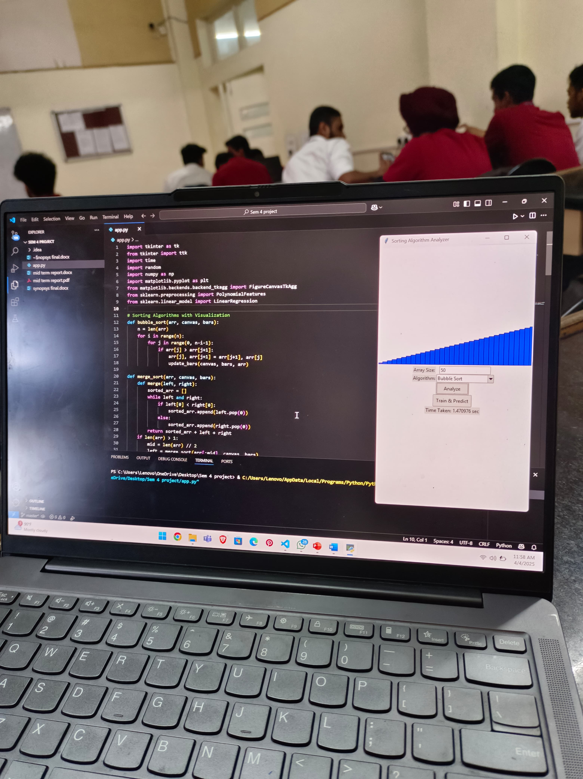
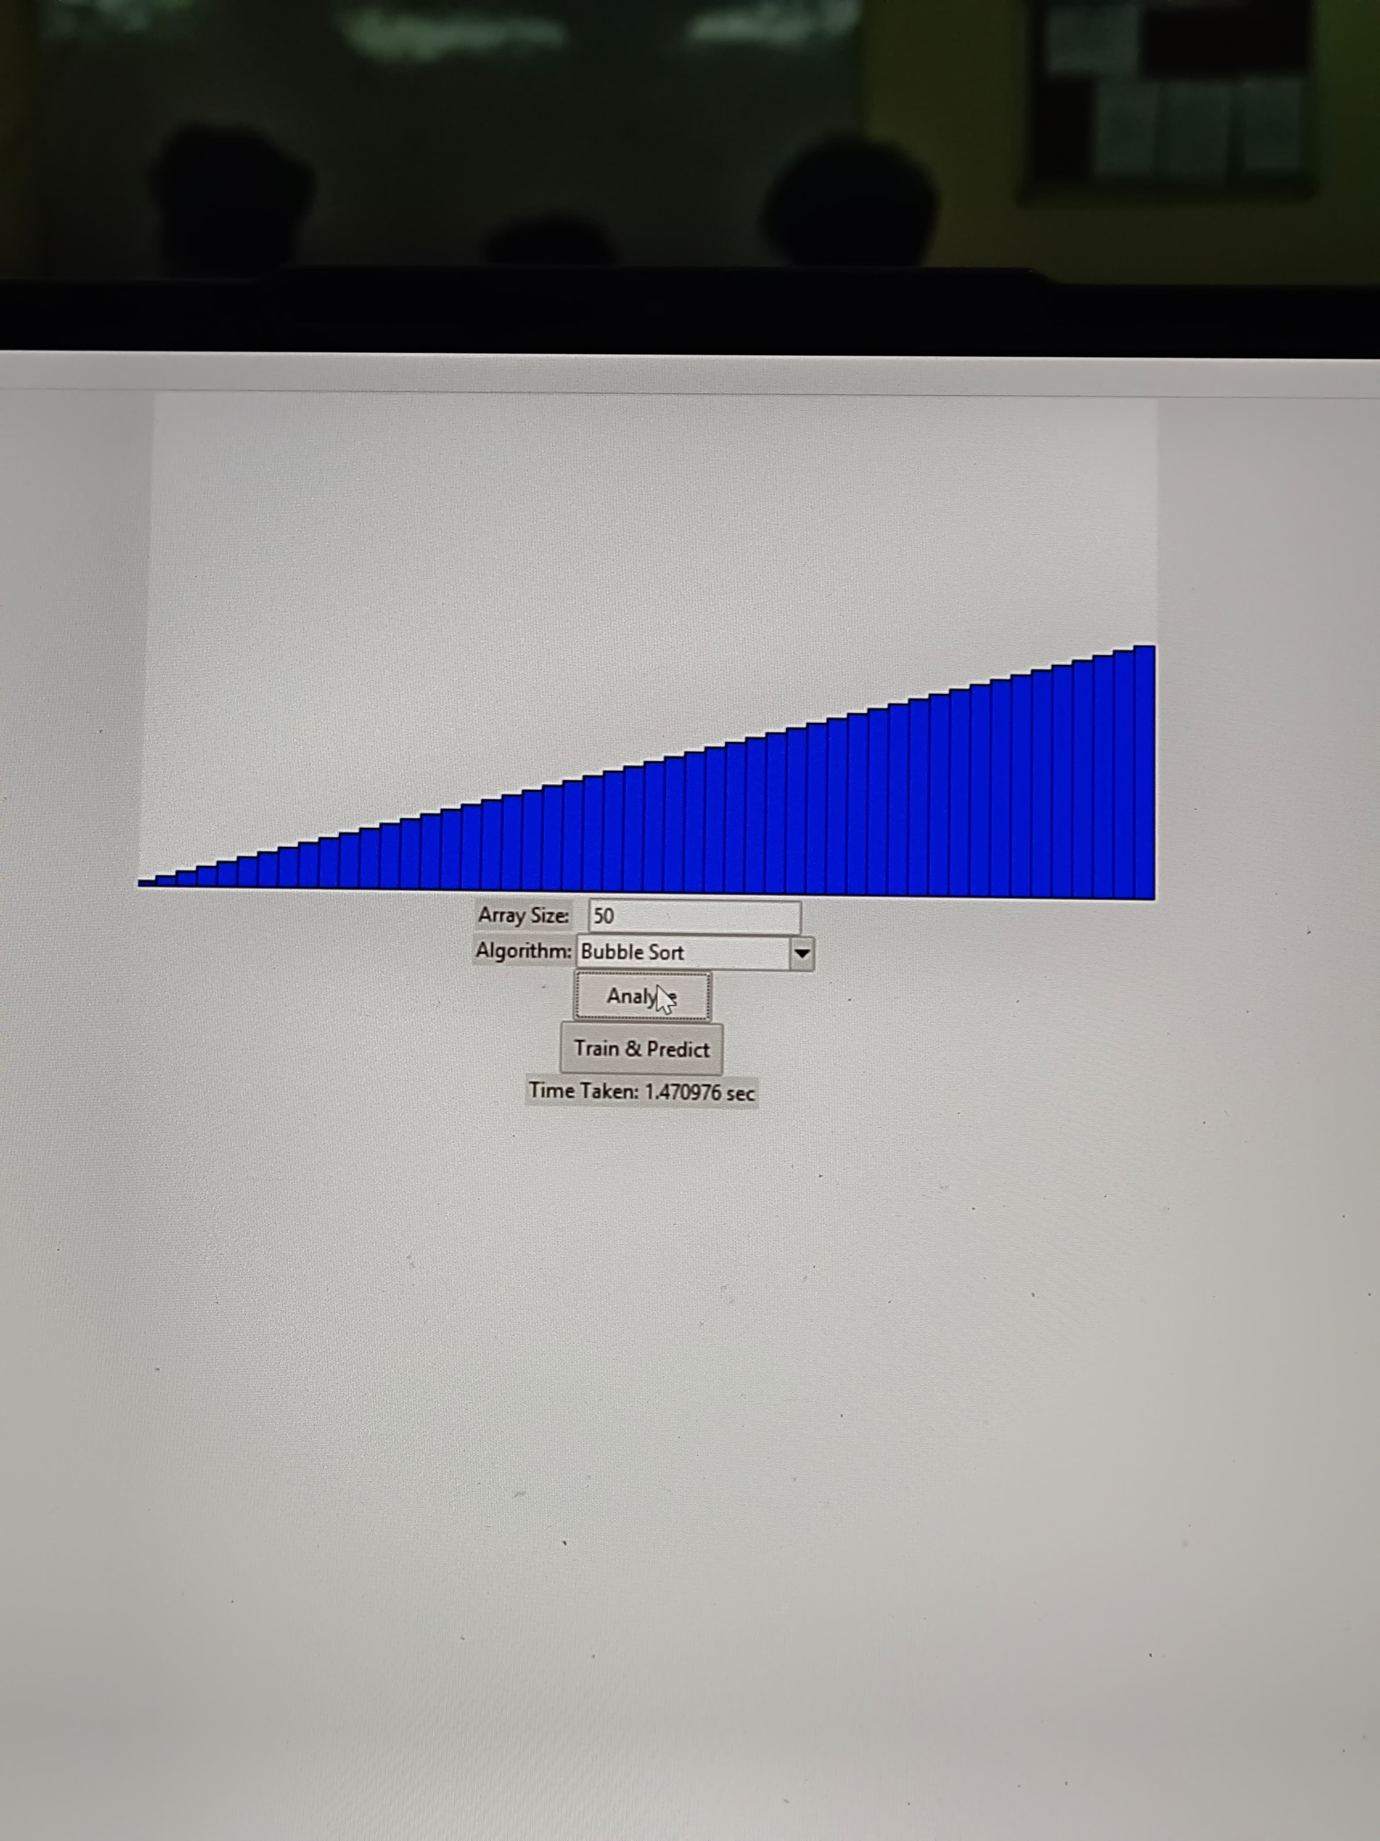
Result and Observation

Slide 14
Thankyou !!!
Any Questions ?? Feel free to ask

